Slide 1
Physical Chemistry
Ying Hu
(Fifth edition)
Bilingual Program
版权所有：华东理工大学物理化学教研室

Slide 2
Part IV Statistics
Chapter 12 Statistical Mechanics of Independent Particle Systems
Bilingual Program
版权所有：华东理工大学物理化学教研室

Slide 3
Framework of the Chapter
General principles of equilibrium at the transition level
from microscopic to macroscopic
I. Principles of Statistical Mechanics
II. Statistical Distributions of Independent Particle Systems
III. Thermodynamic Properties of Independent-Particle Systems
Description of Microscopic States
Thermodynamic Functions
Maxwell-Boltzmann Distribution
  Standard Heat Capacity of Gases
Fundamental Postulates of Statistical Mechanics
  Standard Entropy of Gases
The Most Probable Distribution
  Molecular Partition Function
  Heat Capacity of Crystals
  Standard Equilibrium Constant

Slide 4
II. Statistical Distributions of Independent-Particle Systems
Bilingual Program
版权所有：华东理工大学物理化学教研室

Slide 5
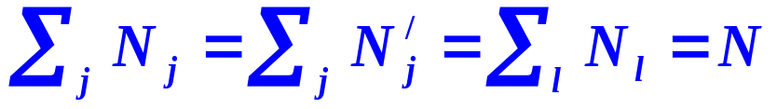
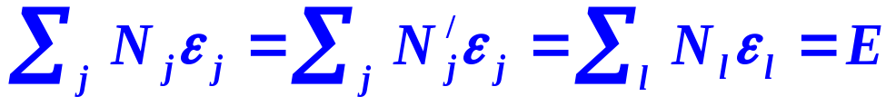
1. Distributions in Independent-Particle Systems
In terms of Energy Levels
A distribution of molecules on energy levels with serial numbers i
Energy level ε₀, ε₁, ε₂, …
Degeneracy g₀, g₁, g₂, …
Number of molecules N₀, N₁, N₂, …
N₀’, N₁’, N₂’, …
Constrains
Conservation of particle
Conservation of energy
Identical average energies

Slide 6
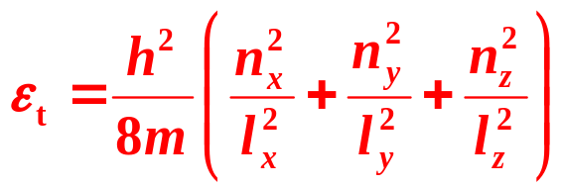
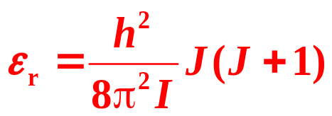
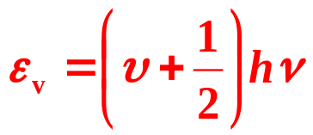






Energy levels (Planck constant h = 0.66260755×10⁻³³J s)
 | Translation | Rotation | Vibration
Energy level
Quantum numbers
Energy spacing
Degeneracy | Depending on the energy level | 2J+1 | none

Slide 7
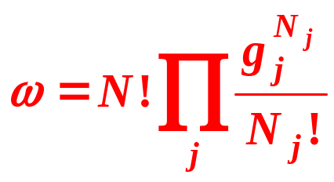
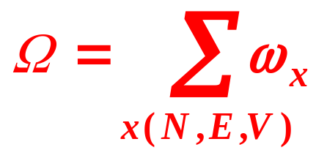

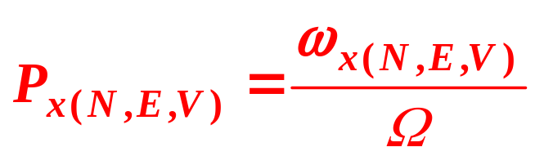
Thermodynamic Probability
The number of microscopic states ω possessed by a distribution x(N,E,V).
The number of total microscopic states Ω possessed by a macroscopic state (N,E,V).
Probability

Slide 8
Framework of the Chapter
II. Statistical Distributions of Independent- Particle Systems
12.5 Maxwell-Boltzmann Distribution
12.6 Molecular Partition Function

Slide 9
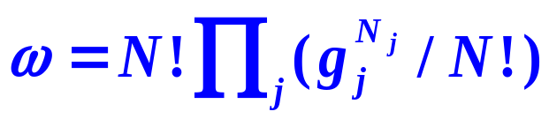
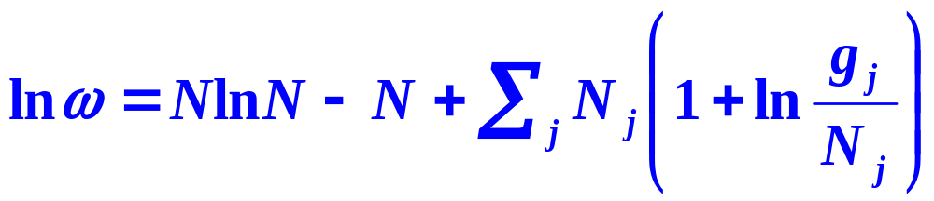
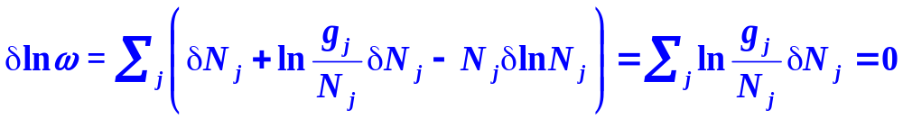
2. Derive the Maxwell-Boltzmann Distribution
(1) Find the Most Probable Distribution
Thermodynamic Probabilities of Distributions
Thermodynamic Probability of the Most Probable Distribution Is a Maximum

Slide 10
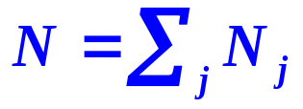
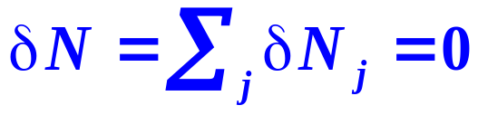
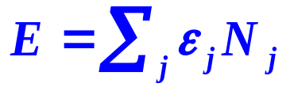
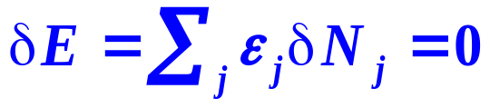
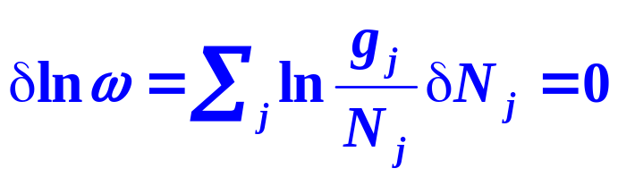
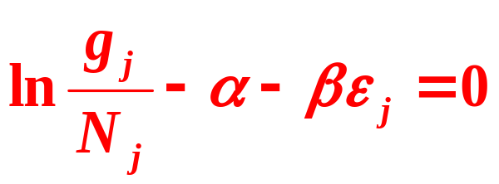
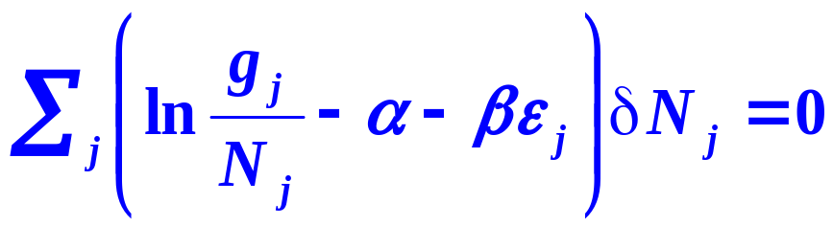

Constraints
Conservation of particle
Conservation of energy
(2) Lagrange Multiplier Method

Slide 11
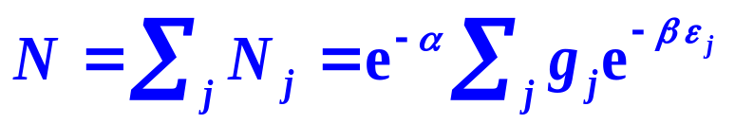
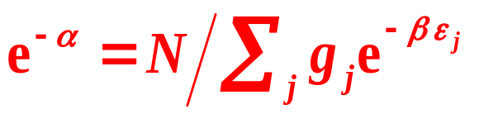
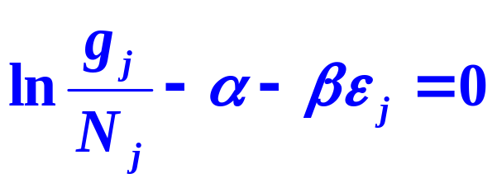
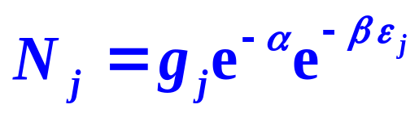
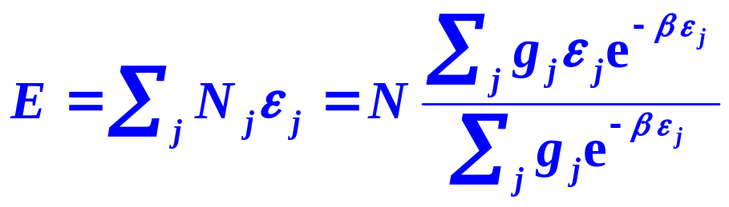
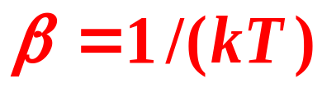
(3) Undetermined Multiplier α and β

Slide 12
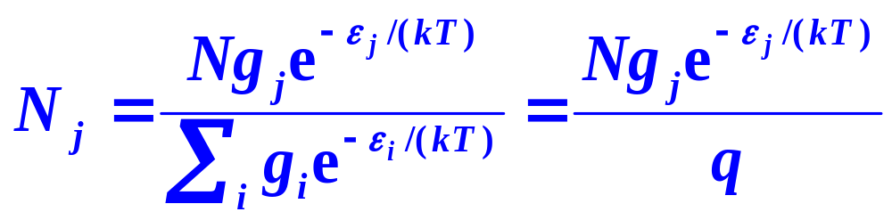
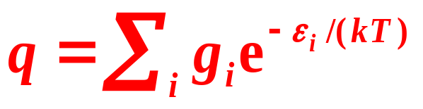
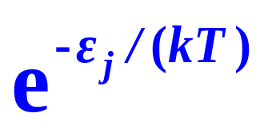
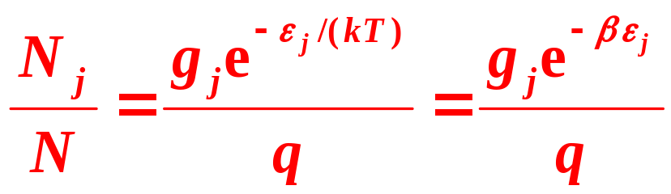

(4) Maxwell-Boltzmann Distribution
Molecular partition function
Boltzmann factor

Slide 13
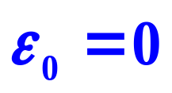
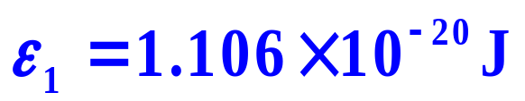
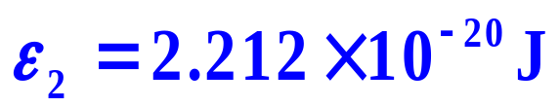
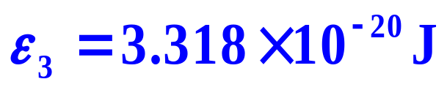
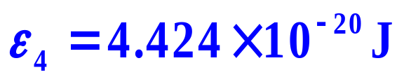
When an independent particle system is at equilibrium, it observers Maxwell-Boltzmann distribution. At 300 K, the lowest five energy levels are:
Suppose they are non-degenerate energy levels, calculate
The Boltzmann factor of each energy level,
The molecular partition function,
(3) The probability of particles appeared at the levels,
(4) The molar energy of the system

Slide 14

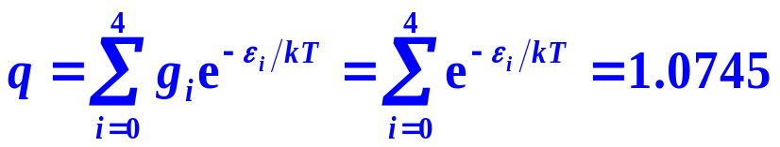
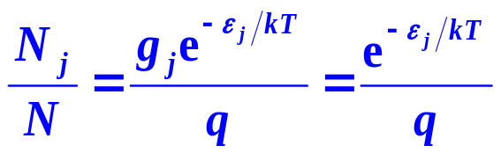
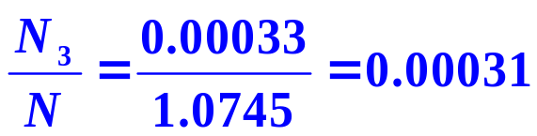
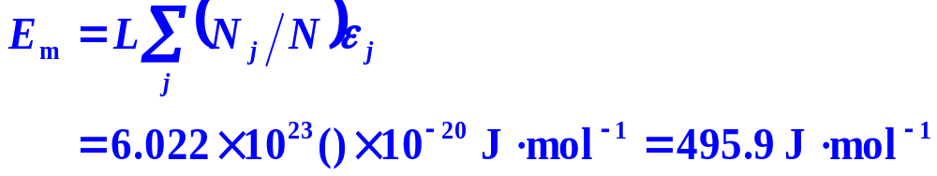
Solution：
(1)
(2)
(3)
(4)

Slide 15
Framework of the Chapter
II. Statistical Distributions of Independent- Particle Systems
12.5 Maxwell-Boltzmann Distribution
12.6 Molecular Partition Function

Slide 16
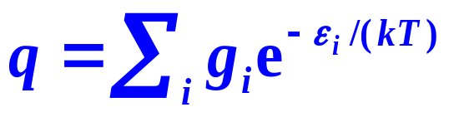
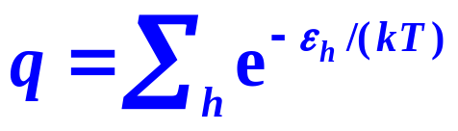
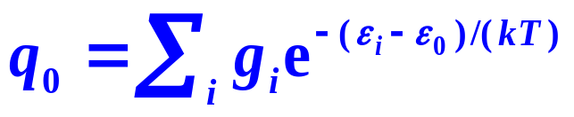
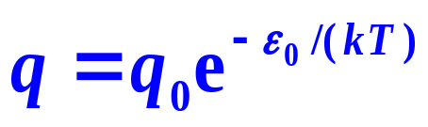
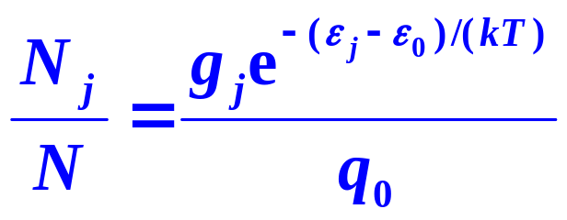
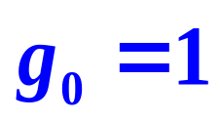
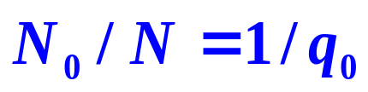
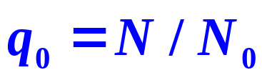
1. Expressions for the Molecular Partition Function
Definition
Ground state energy level

Slide 17
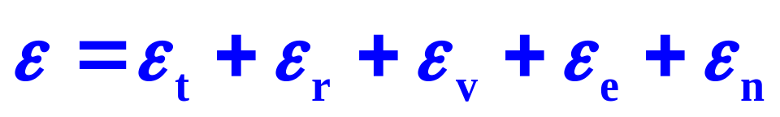
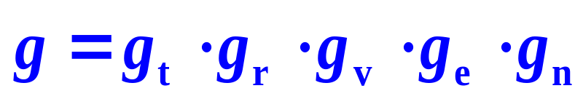

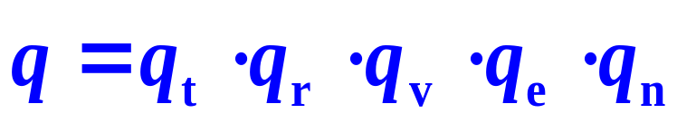
2. Factorial Characteristics of the Molecular Partition Functions
Neglecting the interactions among the degrees of freedom of various motions, the energy of a molecule
The molecular partition function of a molecule can then be expressed by multiplying together the molecular partition functions of various forms of motions.

Slide 18
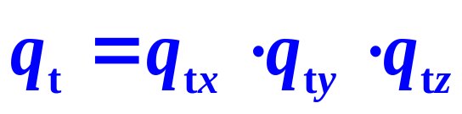
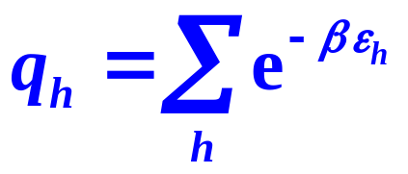







3. Translational Partition Function
Derivation
In terms of Quantum States
z
y
x

Slide 19




Derivation

Slide 20









Determine β
Kinetic theory

Slide 21



Expression of the Translational Partition Function
m——the amount of substance
k —— Boltzmann factor
h —— Planck constant
q_{t} is a function of the temperature and the volume
q_{t} is proportional to the volume of the system then to the amount of substance.

Slide 22





4. Rotational Partition Function
Diatomic Molecules
Rotational temperature
At ambient temperature, ordinary linear molecules,
symmetry number σ, the number of the same configurations appeared when the molecule rotates one cycle around its symmetry axis.
For symmetrical linear molecules, σ = 2,
for non-symmetrical molecules, σ = 1.

Slide 23

4. Rotational Partition Function
Linear Multi-Atom Molecules
As three-dimensional rigid rotator
I_{A}, I_{B} and I_{C} are three principle moments of inertia,
Θ_{rA}, Θ_{rB} and Θ_{rC} are the corresponding rotational temperatures.
The symmetry numbers
σ_{H2O} = 2 σ_{NH3} = 3 σ_{CH4} = 12

Slide 24

The symmetry number, σ(NH₃) = 3
N
R = 120 º
N
H₁
H₃
H₂
H₁
H₂
H₃
R = 120 º
R = 120 º
N
H₃
H₂
H₁

Slide 25

The symmetry number, σ(CH₄) = 12
R = 120 º
H₄
H₄
H₁
C
H₂
C
H₃
H₁
H₂
H₃

Slide 26
The symmetry number, σ(CH₄) = 12
H₄
σ_{CH4} = 3×4 = 12
H₂
C
H₁
H₃

Slide 27





5. Vibrational Partition Function
Diatomic Molecules
As one-dimensional simple harmonic oscillators
Vibrational temperature

Slide 28







Diatomic Molecules
Multi-Atom Molecules
There are 3n−5 and 3n−6 vibrational degrees of freedom for linear and non-linear molecules

Slide 29

6. Electronic Partition Function
Due to large spacing between the different electronic energy levels, most electrons are difficult to be excited.
7. Nuclear Partition Function
Ordinary physical and chemical changes are irrelevant to the nuclear changes, therefore, q_{0n} is usually not considered.

Slide 30



8. Properties and Significance of the Molecular Partition Functions
(1) The molecular partition functions reflect the distributions of all the particles of the system in terms of various energy levels or quantum states. They are the summation of various microscopic states relevant to the macroscopic state of the system.

Slide 31
8. Properties and Significance of the Molecular Partition Functions
(2) At the fixed temperature and volume, the molecular partition functions can be calculated by those microscopic molecular characteristic properties, they are the ties connecting the microscopic properties and the macroscopic properties
(3) q_{r}, q_{v}, q_{e}, q_{n} are intensive properties. q_{t} and q=q_{t}q_{r}q_{v}q_{e}q_{n} are extensive properties.
(4) q increases with the temperature.
At the same temperature, q_{t} >q_{r}>q_{v}.
For 1mol of N₂ at 298K and 0.0245m³,
q_{t}=3.51×10³⁰, q_{r}=51.6, q_{v}=3.39×10⁻³, q=q_{t}q_{r}q_{v}=6.14×10²⁹

Slide 32


Example
Calculate the rotational and vibrational partition function for HI at 373 K. Given that the rotational momentum of inertia is
and the vibrational frequency is

Slide 33






Solution

Slide 34
III. Thermodynamic Properties of Independent-Particle Systems
Bilingual Program
版权所有：华东理工大学物理化学教研室

Slide 35
Framework of the Chapter
III. Thermodynamic Properties of Independent -Particle Systems
12.7 Thermodynamic Functions of Independent-Particle Systems
12.8 Standard Molar Heat Capacity of Gases
12.9 Heat Capacity of Crystals
12.10 Standard Molar Entropy of Gases
12.11 Standard Equilibrium Constant of Gaseous Reactions

Slide 36




1. Energy of the Independent-Particle Systems
Statistical Average
Relation between Energy and the Molecular Partition Function

Slide 37



Energy Equipartition Theorem
If the temperature is high enough

Slide 38

Energy Equipartition Theorem
The energy of the thermal movements is allocated in terms of the degrees of freedom of the motions of the molecule. Each degree has an energy of NkT/2 in principle.
For a diatomic molecule, there are 3 translational and 2 rotational degrees of freedom, with energies of 3NkT/2 and NkT.
Vibrational energy is composed of two parts, the kinetic energy and the potential energy. So one degree vibrational motion is with energies of NkT.

